Slide 1

Hey Guys!
Welcome to my channel
CHUSI_NERCHUKORA

Slide 2
AGENDA
Why Cryptography ?
Cryptography definition ?
Example for Cryptography?
Encryption and Decryption?
Plain text and cipher text ?
Introduction to Classification of Cryptography?
Applications of Cryptography?

Slide 3

why cryptography ?

Slide 4





CRYPTOGRAPHY
Reads data and sends back to receiver
Unauthorized person
Try’s to hack data
Sent mail
Received mail
Receiver
Sender

Slide 5
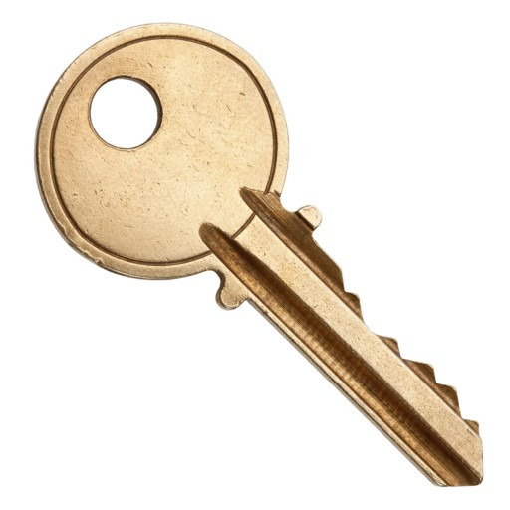
CRYPTOGRAPHY DEFINATION:-
The science of transforming information into an unintelligible form while it is being transmitted or stored so that unauthorized users cannot access it
EXAMPLE:
ENCRYPTION
Decryption
Hi Receiver,
budget is 6000
Original data +key
i.e 6000+123=6123
Received data-key
i.e 6123-123=6000
Sender
Receiver

Slide 6
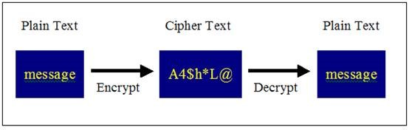
PLAIN TEXT AND CIPHER TEXT
Plain text :-The data which is in readable format is called plain text
For example:-
ABC
Cipher Text :- The data which is not in readable format is called Cipher text
For example
ABC + $#% (KEY)= A4$h*L@
Hi Receiver,
budget is 6000
i.e 6000+$%^=
A4$h*L@

Slide 7
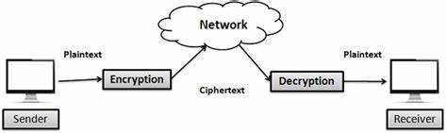
Encryption and decryption:-
Encryption:-
Process of encoding information, which is conversion of the original representation of the information, known as plaintext, into an alternative form known as ciphertext
Decryption
Process of decoding information, which is conversion of the encrypted known as ciphertext, into an the form known as plaintext i.e original information

Slide 8
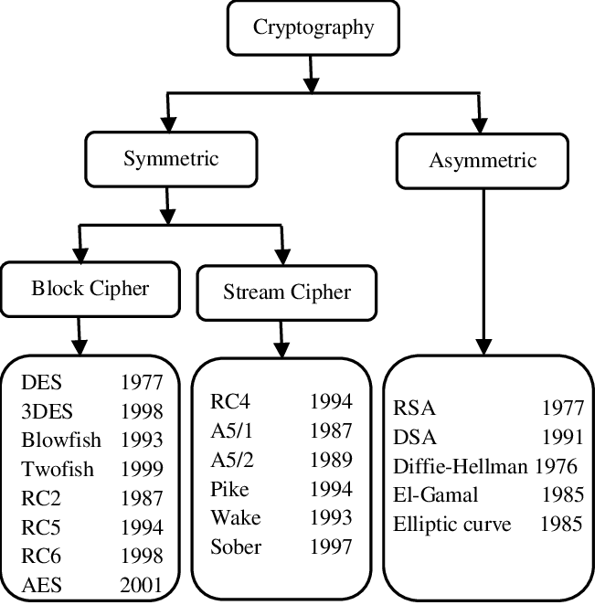
CLASSIFICATION OF CRYPTOGRAPHY

Slide 9
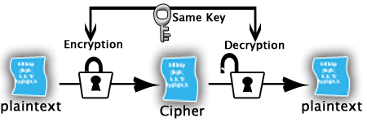
SYMMETRIC ENCRYPTION:-
symmetric encryption use only one keys, for both encryption and decryption
Oldest and best technique
they are classified into 2 types i.e
1)Block cipher
2)Stream cipher

Slide 10
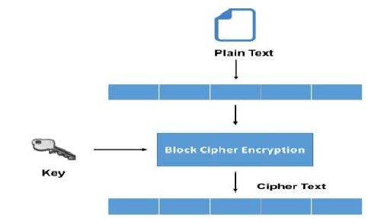
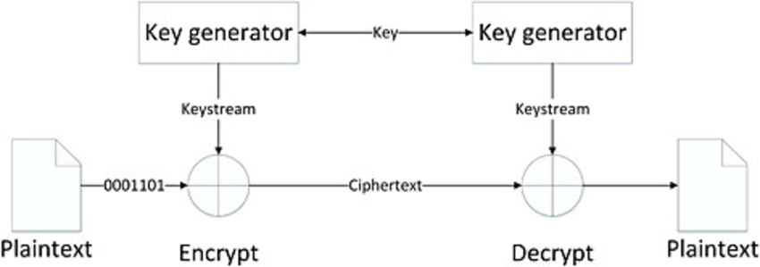
BLOCK CIPHER AND STREAM CIPHER
Block cipher:-
Stream cipher:-
Type of symmetric key cipher at converts the plain text into cipher text by converting plaintext block wise at a time
Involves in dividing the plain text to large blocks to convert it into cipher
Simpler than stream cipher
Uses 64 bit or more at a time
Type of symmetric key cipher that converts the plain text to cipher text by converting one byte of plain text at a time
Involves in dividing the plain text to bytes to convert it into cipher text
Complex than block cipher
Uses 8 bits at a time

Slide 11
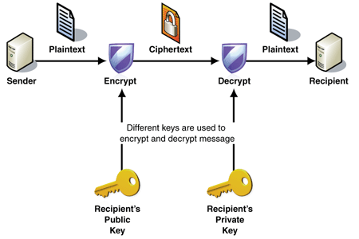
ASYMMETRIC ENCRYPTION:-
Asymmetric encryption use two keys, one to encrypt the data, and another key to decrypt the data. These keys are generated together.
One is named as Public key and is distributed freely. The other is named as Private Key and it is kept hidden Both Sender & Recipient has to share their Public Keys for Encryption and has to use their Private Keys for Decryption.

Slide 12
GREAT!
Now We know
Why and What is cryptography
What is encryption &Decryption
Plain text ,cipher text
Symmetric and Asymmetric

Slide 13
BUT
WHERE DO WE USE
THIS CRYPTOGRAPHY
IN REAL TIME
?

Slide 14
APPLICATIONS OF CRYPTOGRAPHY
EMAIL-PASSWORD (database)
storing passwords into database
E-PAYMENT
encrypting bank details
File Systems
A filesystem such as a hard drive in a laptop may be encrypted such that a password is required to access data.
Devices
Devices such as mobile phones may be designed to use encrypted data storage by default.

Slide 15


